Slide 1
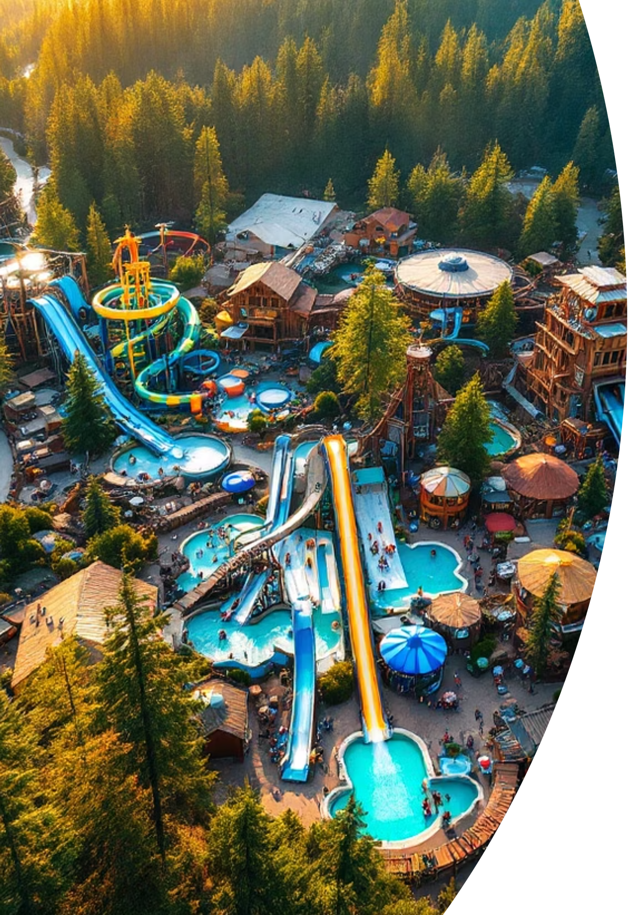

Locale-Aware Experience: How We Boosted International Conversions at Timber Mountain
A data-driven approach to understanding and serving our growing international audience
July 2024
by Andre Rand

Slide 2

The Challenge: One-Size-Fits-All Doesn't Fit Everyone
Current Situation
Timber Mountain welcomes ~4M guests annually, with a fast-growing share of international tourists drawn by California's national-park loop and the Bay Area tech corridor.
Key Issues Identified:
Homepage shows USD pricing, US-specific policies, English-only copy
International visitors bounce 18% more often
35% lower conversion rate for international guests
"I'm not sure your park even sells tickets to UK residents"
— UK mom, January 2024 Customer Interview

Slide 3
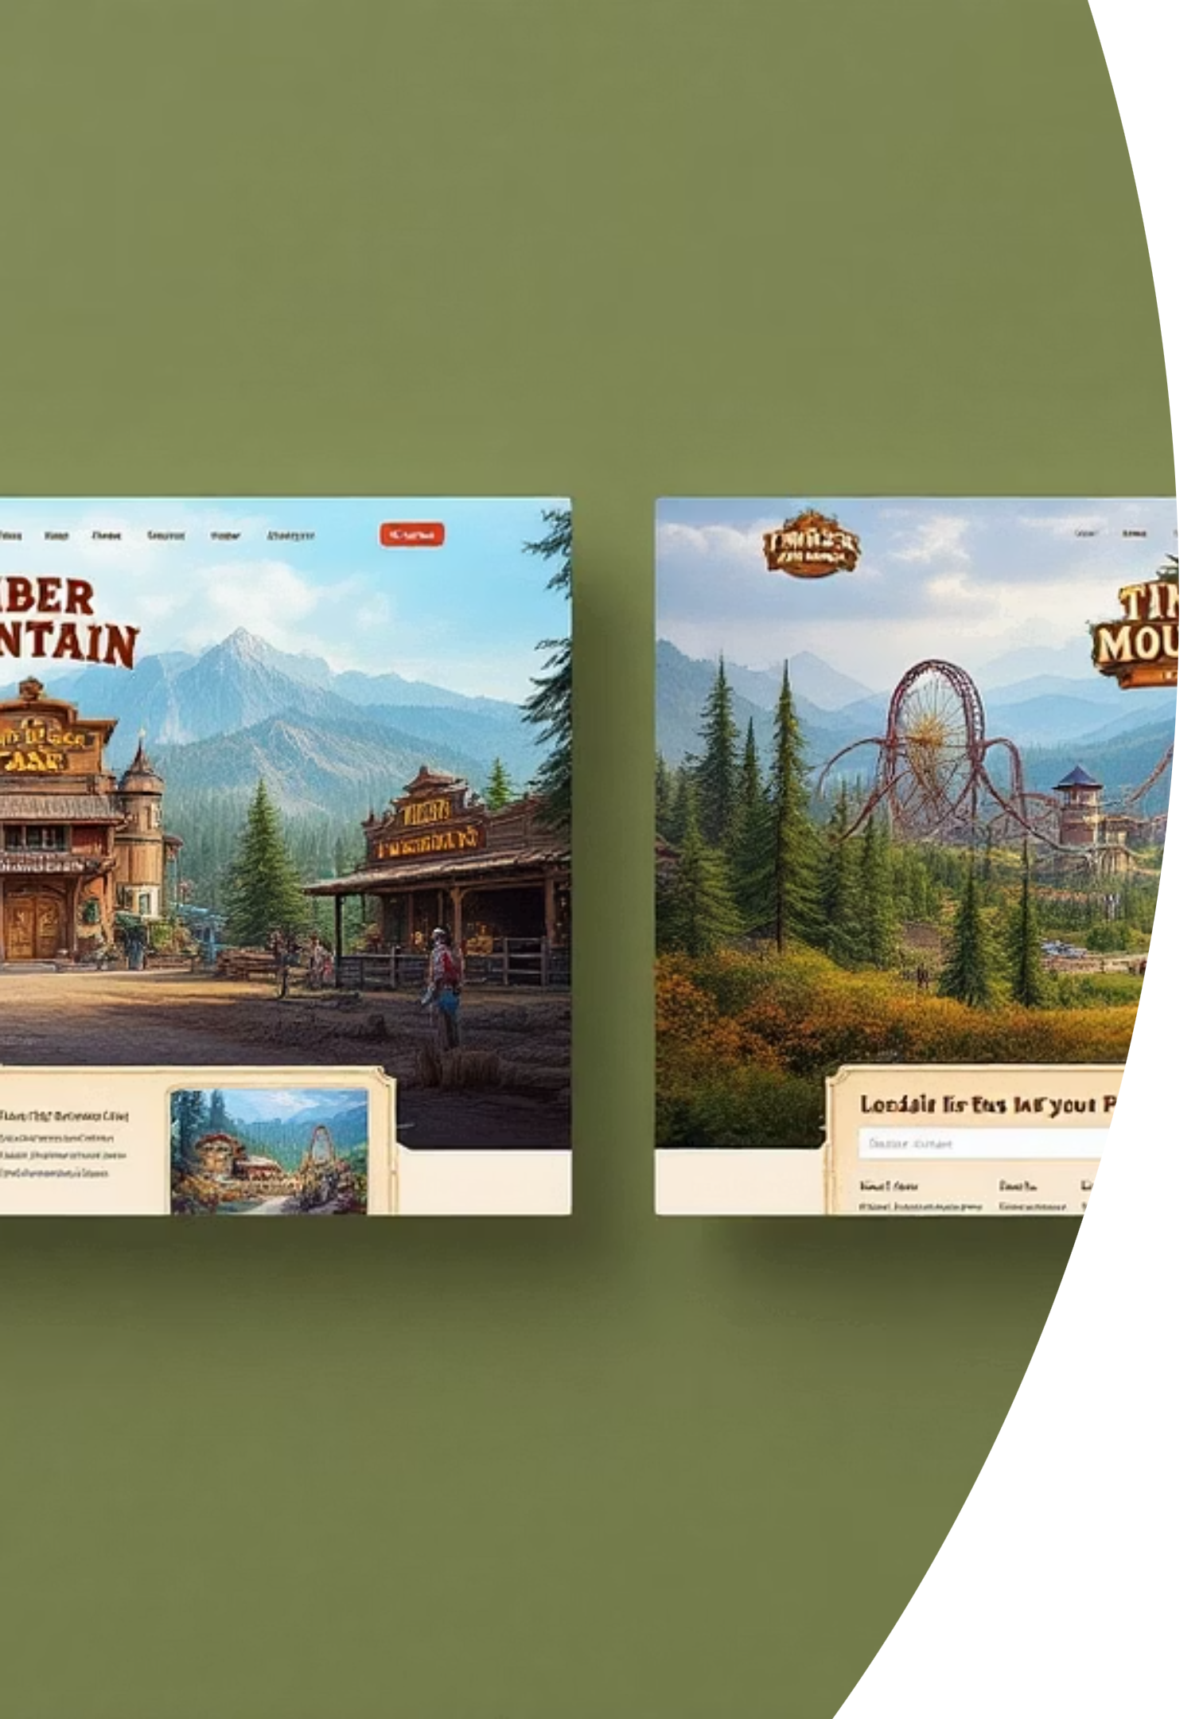



Our Hypothesis: Personalization Drives Conversion
If we localize content for non-US visitors...
Adapt copy, imagery, and currency based on visitor locale
International visitors will feel "seen"
Creating a more welcoming first impression
Purchase conversion will increase
Target: ≥5% lift in ticket purchases

Slide 4
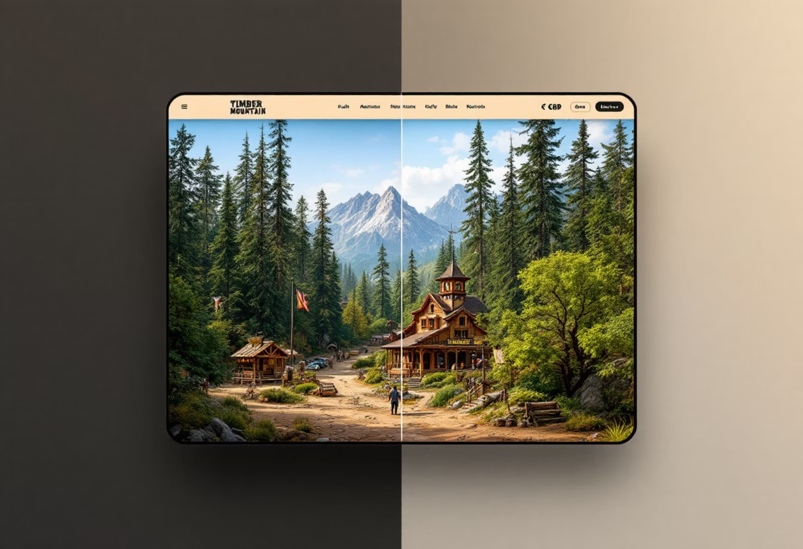
Test Design: Creating a Localized Experience
Control Experience
Standard global homepage
Hero image: log-flume riders
Pricing displayed in USD only
"Plan Your Visit" CTA
Treatment Experience
Locale-personalized homepage
Region-specific hero images (e.g., UK family)
Local currency (e.g., £54.99 GBP)
Localized date formats (DD/MM/YY)
"Book Your Adventure" CTA
Implementation used Accept-Language + MaxMind GeoIP with a 250ms timeout fallback to control (affecting only 0.3% of traffic)

Slide 5
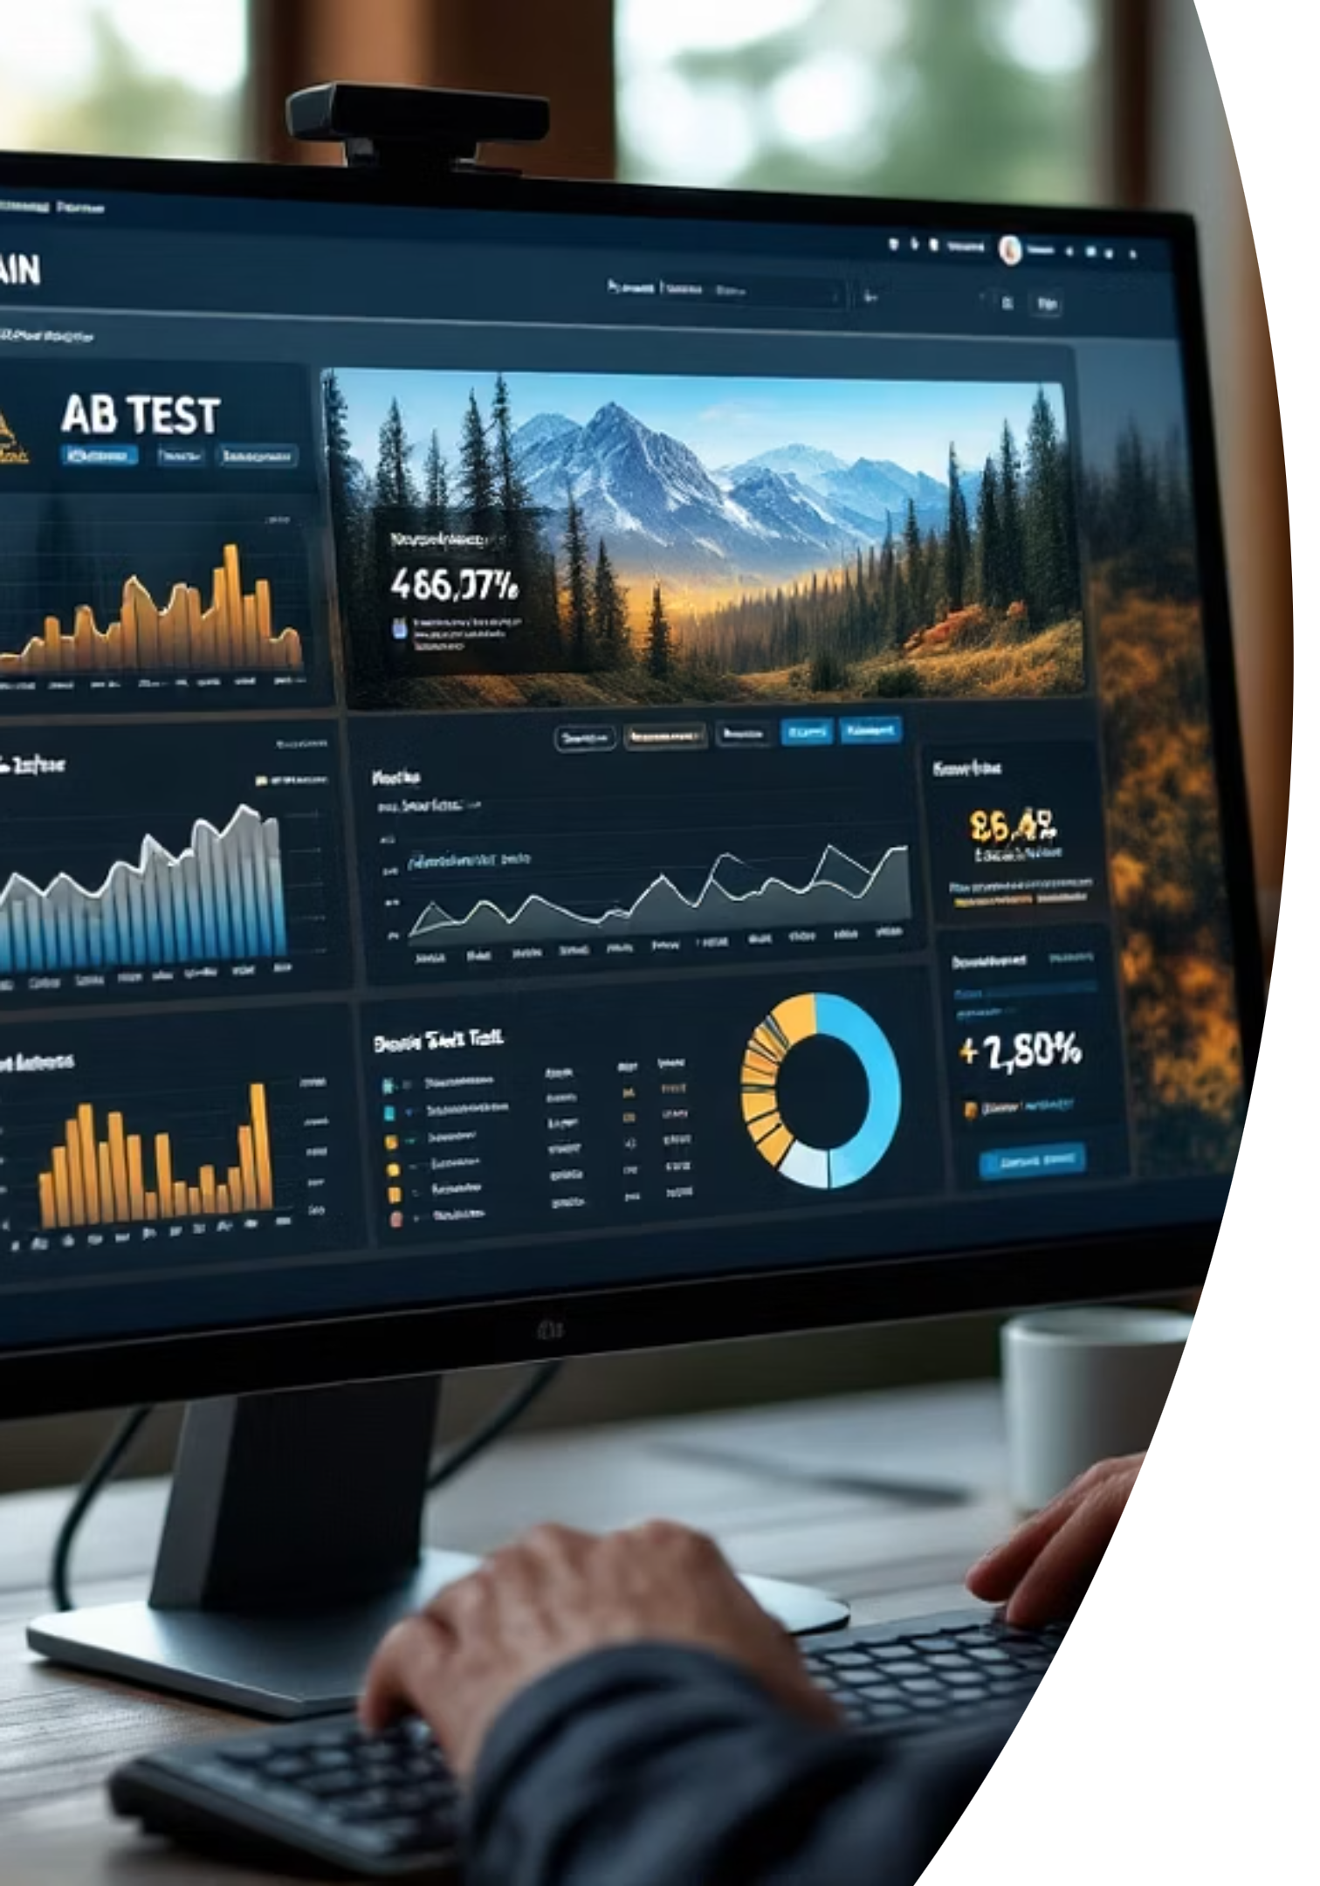
Test Methodology: Rigorous, Controlled Evaluation
1
Test Parameters
Countries: US & Canada (Domestic) vs. Rest-of-World (International)
Duration: July 8-28, 2024 (3 full weekends)
Split: 50/50 random assignment at session start
Statistical power: 95% for medium effect size
2
Measurement Framework
Primary KPI: Ticket-purchase conversion (same-session)
Secondary KPIs: Homepage bounce rate, Add-to-Cart actions, Trip-Planner engagement
Analysis: Two-tailed z-test on proportions (α = 0.05)

Slide 6
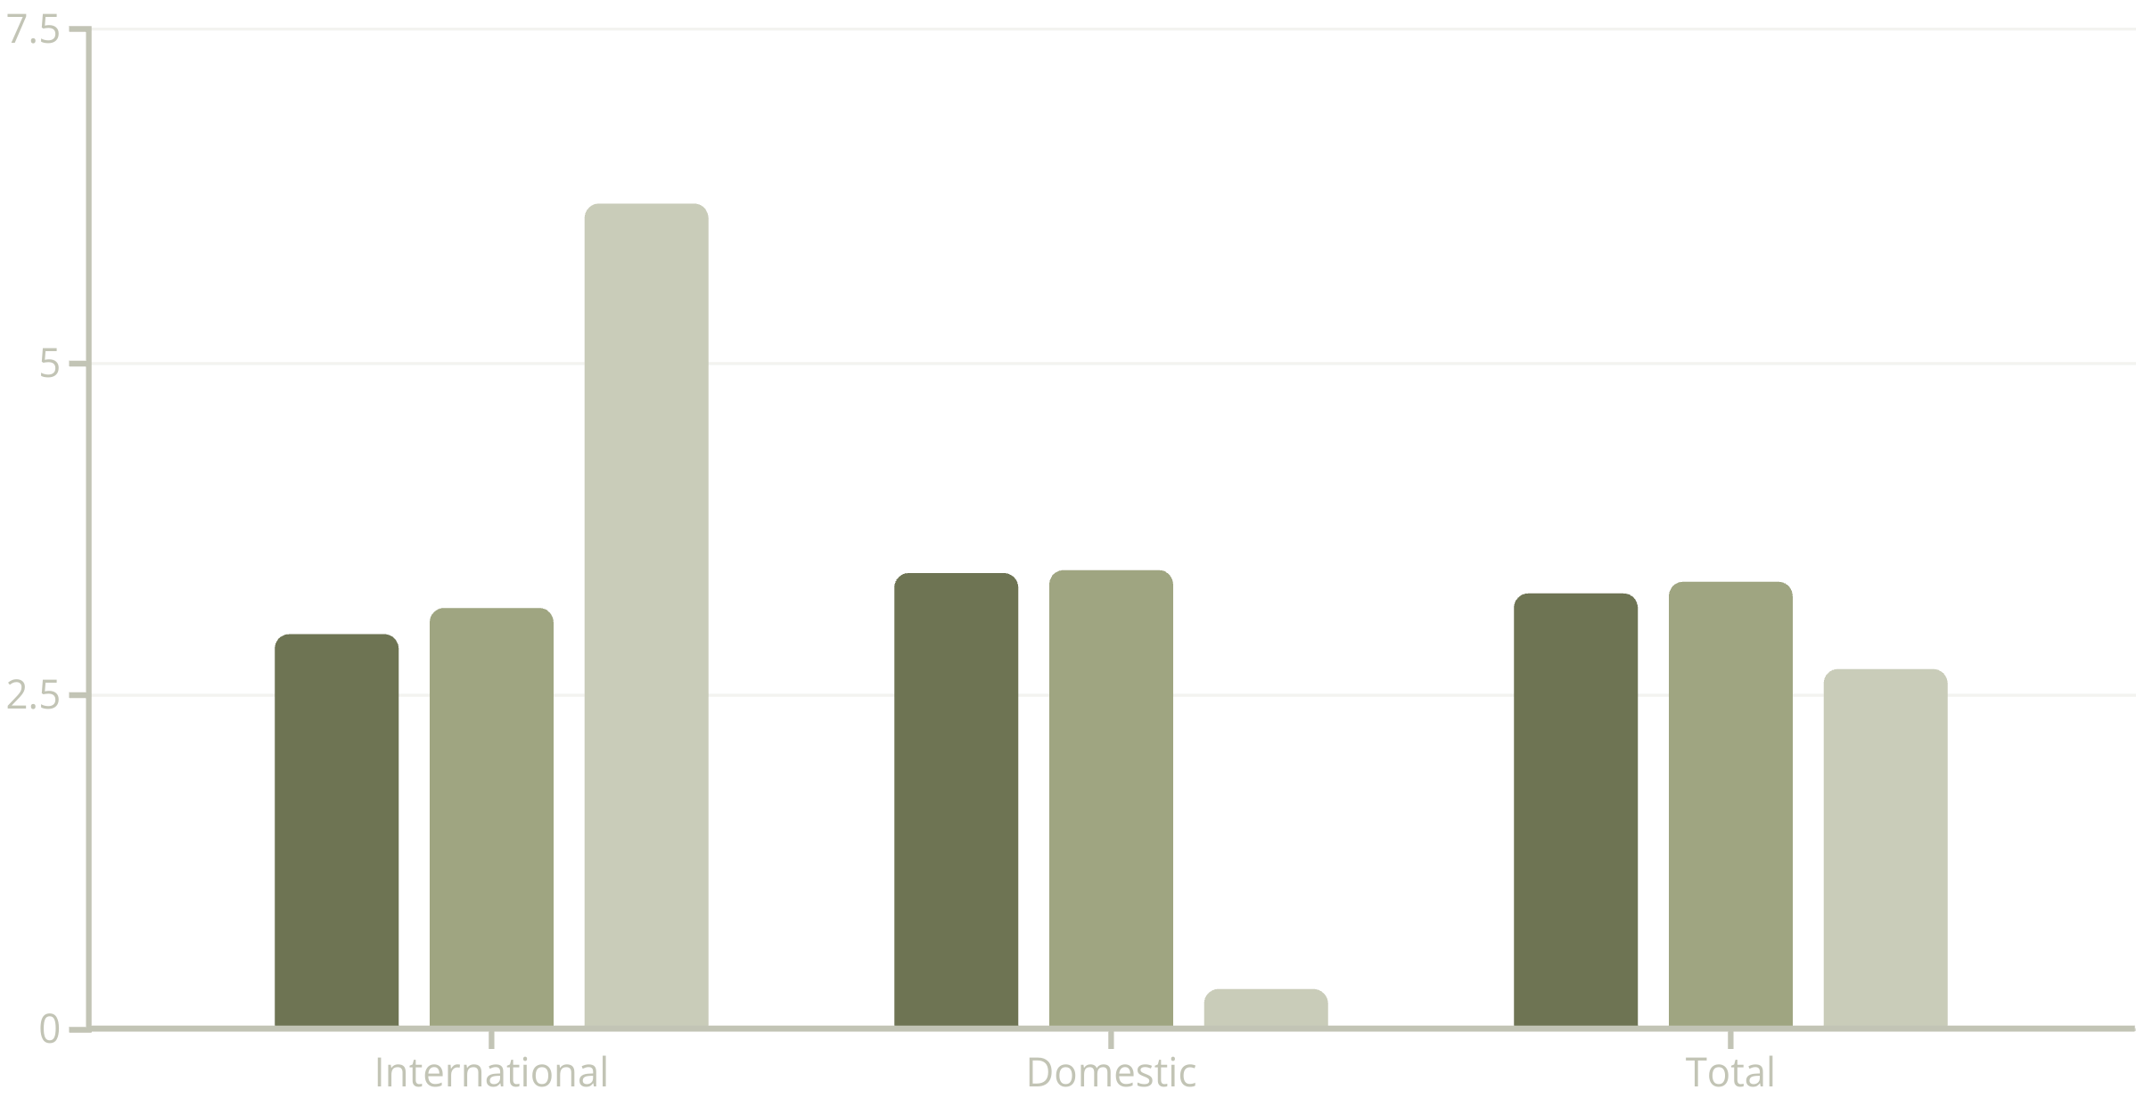
Results: Meaningful Improvement for International Visitors
Control
Treatment
Lift
1
Key Success Factors
Local currency display reduced "price-translation" friction (41% fewer FAQ: currency clicks)
Regionally-relevant hero images increased scroll depth by 12% for international users
No performance penalty: personalization JSON ≤ 9kB with no impact on 95th percentile FCP

Slide 7
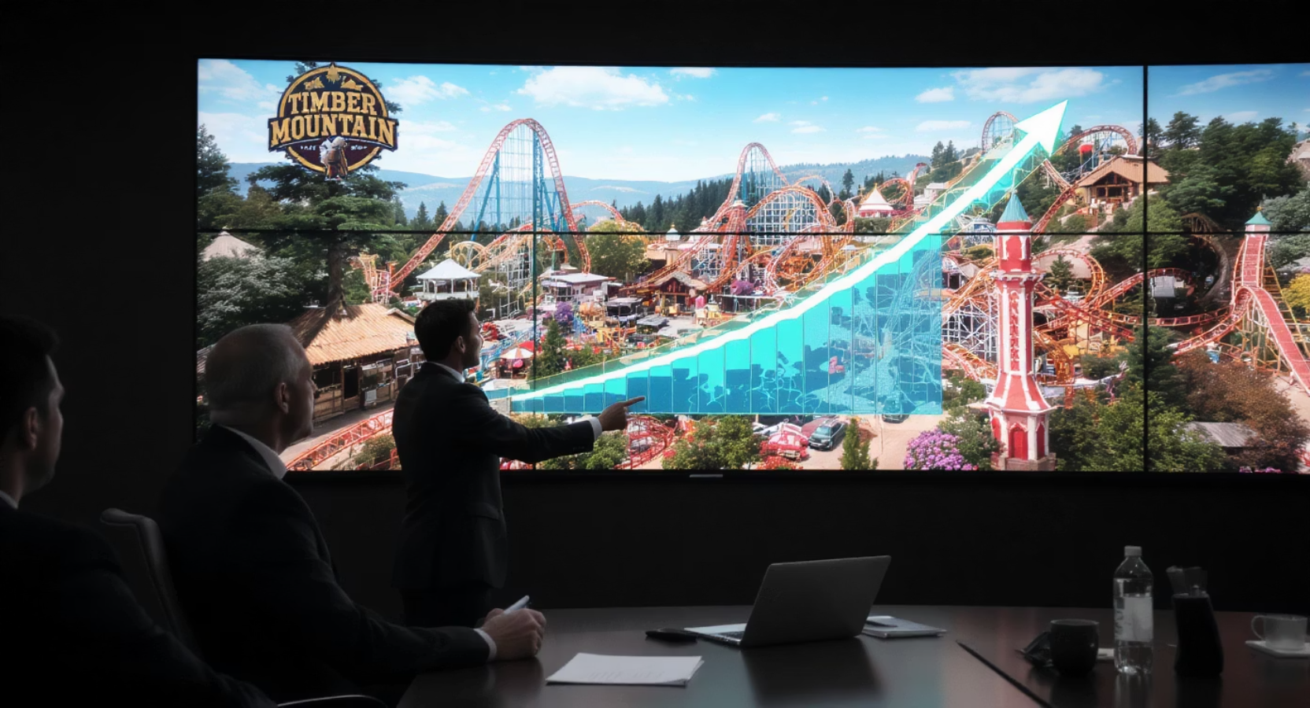
Business Impact: Clear Win for User Experience and Revenue
+6.2%
+10K
Int'l Conversion Lift
Annual Tickets
Statistically significant improvement (p=0.018)
Projected incremental ticket sales
$720K
Revenue Impact
Why This Matters:
Annualized revenue increase
Significant lift among our previously underperforming audience segment
No regression for domestic traffic or page performance
Maintains experience consistency while improving personalization

